Slide 1
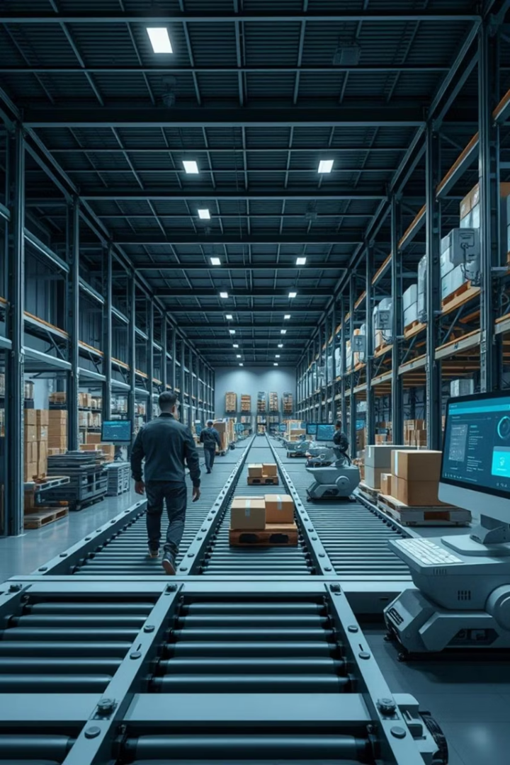
Logistics & Supply Chain Management in Java
Exploring the intersection of logistics, Supply Chain Management, and object-oriented programming (OOPs) in Java.
Focus on reducing costs, improving supply chain efficiency and management.

Slide 2

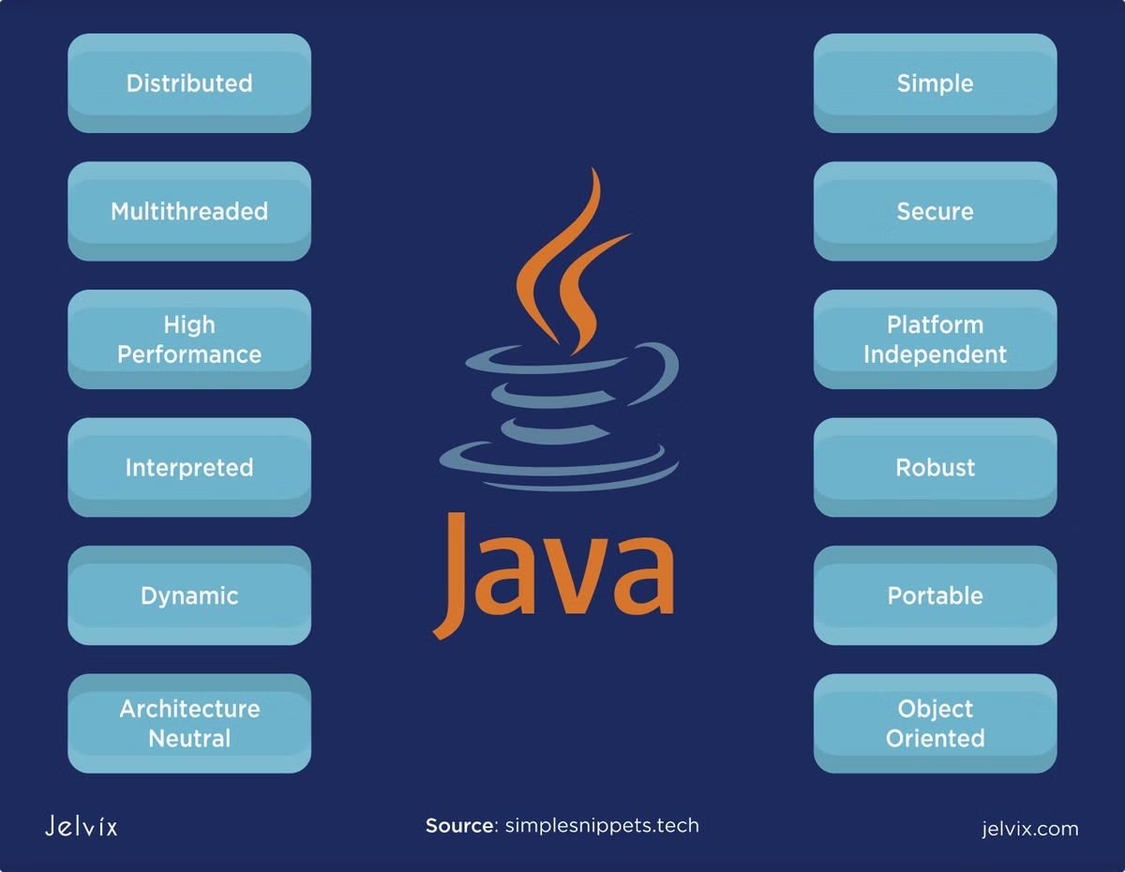
Core Classes & OOPs Principles
Product & Warehouse
Order & Shipment
Manage product details and warehouse locations with encapsulation.
Track orders, shipments, and delivery dates using inheritance and polymorphism.
OOPs Features
Encapsulation for data hiding
Inheritance for specialized classes
Polymorphism for method behaviour
Abstraction for removing complexity

Slide 3

Exception Handling
Robust Error Management
Custom Exceptions & Logging
Use try-catch blocks to gracefully handle invalid orders and stock discrepancies.
Define specific exception classes for different error scenarios for better clarity and handling.
Recover from shipment delivery failures by retrying or escalating issues.
Implement comprehensive logging to track errors and system events.
Validate inputs before processing to prevent exceptions.
Use logs to monitor system health and facilitate debugging.
Ensure system stability during runtime errors with fallback strategies.
Integrate alerts based on critical exceptions for proactive issue resolution.

Slide 4
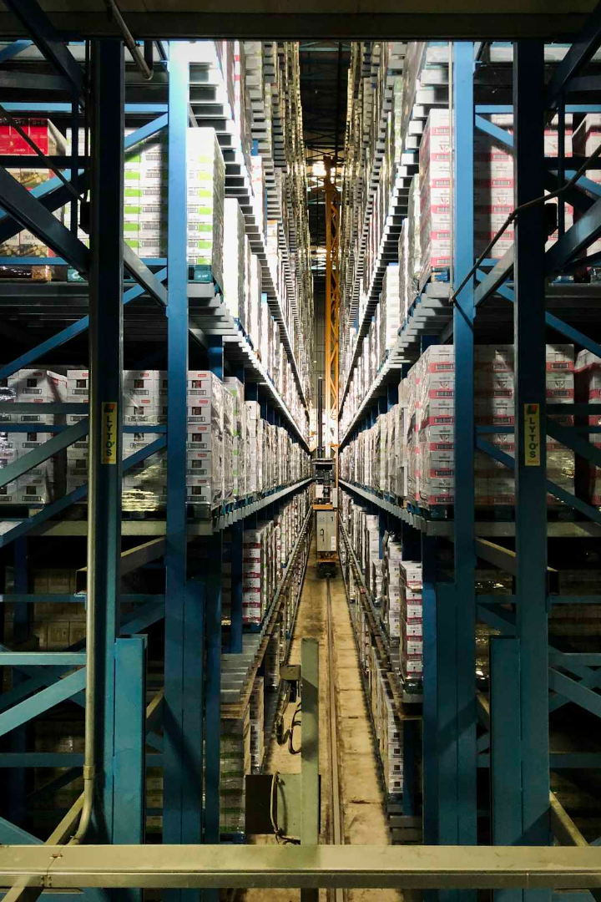
Threading for Parallel Processing
1
Concurrent Order Processing
Handle multiple orders simultaneously using threads.
2
Asynchronous Inventory Updates
Update stock levels across warehouses in parallel.
3
Real-time Shipment Tracking
Track multiple shipments concurrently to improve visibility.
4
Performance Gains
Reduced processing time using ExecutorService pools.

Slide 5

Java Swing for User Interface
GUI Modules
Components & Events
Order management: create, update, view
JFrame, JPanel, JButton, JTextField, JTable
Inventory tracking and reports
ActionListener for button events
Shipment updates
TableModelListener for data updates
User authentication interfaces
Settings and preferences panels
WindowListener for window events
MouseListener and KeyListener for user interaction
Java Swing provides a flexible and customizable framework for building desktop applications with rich user interfaces. Event-driven programming allows real-time responsiveness to user actions, making the system interactive and efficient.

Slide 6

Interfaces for Modularity
Advantages
Implementations
Loose coupling between components leads to a scalable and maintainable architecture. Interfaces promote easier testing, enhanced code readability, and the ability to extend functionality with minimal impact on existing code.
Interface
Create concrete classes that fulfill these interfaces, encapsulating specific business logic and allowing flexibility in substituting different implementations without affecting system components.
Define clear contracts such as OrderProcessor and InventoryManager to specify expected behaviors and interactions. These interfaces serve as blueprints that enforce consistency across implementations.

Slide 7
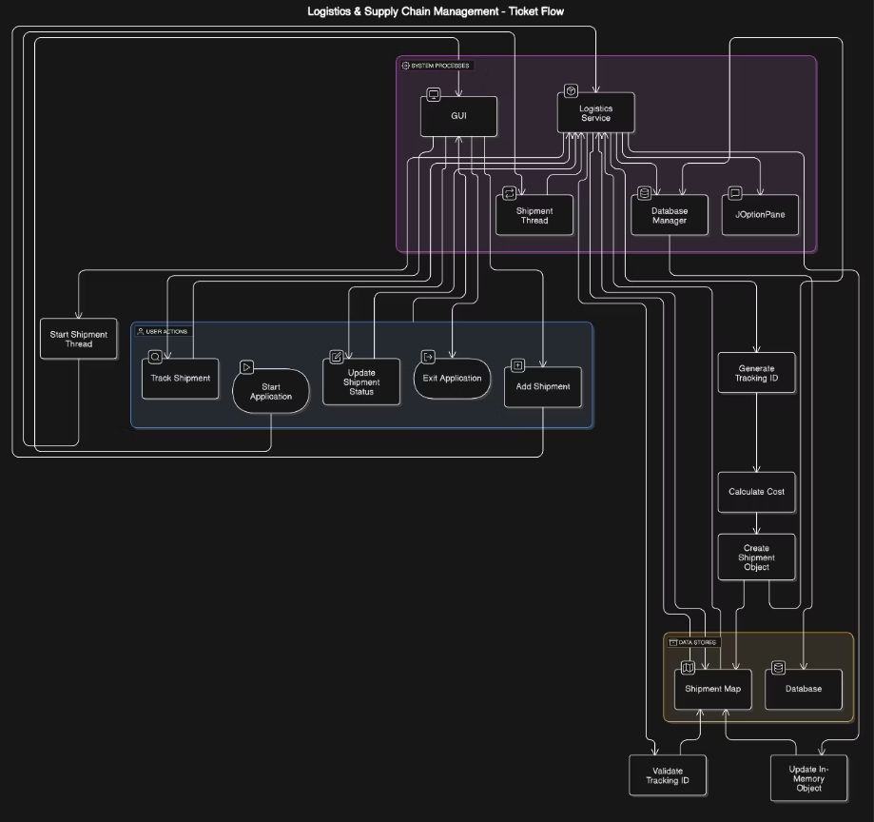
DATA FLOW DIAGRAM

Slide 8
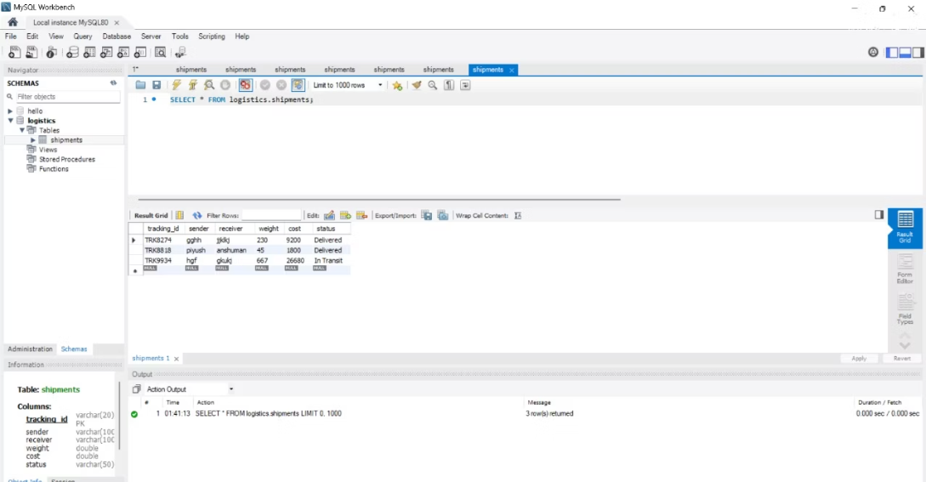
Use of JDBC in this Project
JDBC (Java Database Connectivity) is utilized to enable communication between the Java application and the relational database.
It facilitates executing SQL queries to store, retrieve, update, and manage data related to orders, inventory, and shipments effectively.
By leveraging JDBC, the project ensures reliable data persistence, transaction management, and seamless integration with underlying databases for real-time data access and updates.
This integration supports robust backend operations, allowing efficient management of logistics data and improving overall system responsiveness.

Slide 9

Conclusion & Future Enhancements
Project Highlights
Future Opportunities
Leveraged Java OOPs to enhance logistics and reduce costs.
Integrate real-time APIs, machine learning, and blockchain tech.
Route Optimization
Find the shortest routes for shipment

Slide 10
THANK YOU
Project Members :
1) Anshuman Mohapatra
Batch - 3 (500119016)
2) Piyush Arora
Batch - 3 ( 500121925)

